Slide 1
Fundamentals of Natural Language Processing

Slide 2
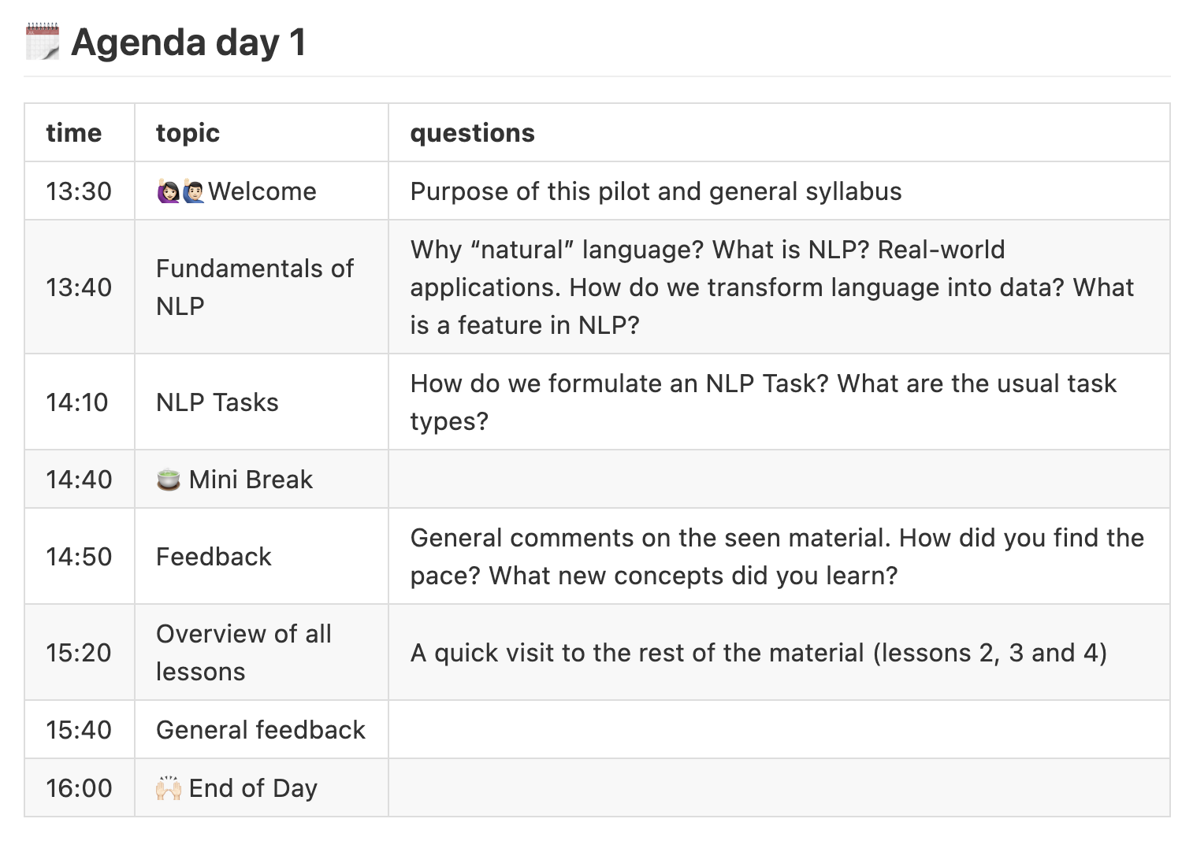

Slide 3
Syllabus – Day 1
Introduction
NLP Fundamentals
Language as Data
NLP Tasks
A primer on linguistics
Word Representations
Preprocessing Operations
NLP Pipeline
Word Embeddings
Train your own Word2Vec

Slide 4
Syllabus – Day 2
Transformers
The Transformer Architecture
BERT as a Language Model
BERT for Text Classification
BERT for Token Classification
Large Language Models (LLM)
Interacting with LLMs
LLMs for NLP Tasks
LLM Selection Criteria
How are LLMs trained?

Slide 5
What is Natural Language Processing (NLP)?

Slide 6
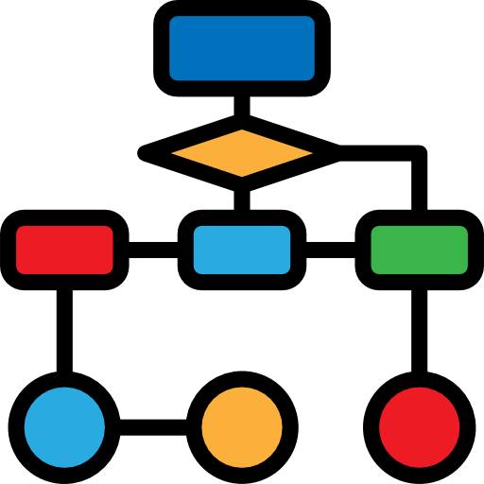


Why “Natural” Language?
Artificial Language:
Computers excel at following
deterministic instructions
Human Language:
Language is ambiguous and
highly context-dependent

Slide 7
What is Natural Language Processing?
Computer Science
Artificial Intelligence
Machine Learning
Linguistics
Natural Language Processing
Deep Learning
LLMs

Slide 8
What is Natural Language Processing?
NLP is an area of research and application that focuses on making human languages processable for computers.
More than 7000 human languages are spoken around the world, each with its own grammar, vocabulary, and cultural context.
Today we focus on written English, we leave out speech and video, as they require a different kind of input processing.
Most linguistic concepts remain valid across languages, however they might require different approaches

Slide 9
Challenge 1
Name at least three tools/products that you use on a daily basis and that you think leverage NLP techniques. To do this exercise you may make use of the Web.

Slide 10



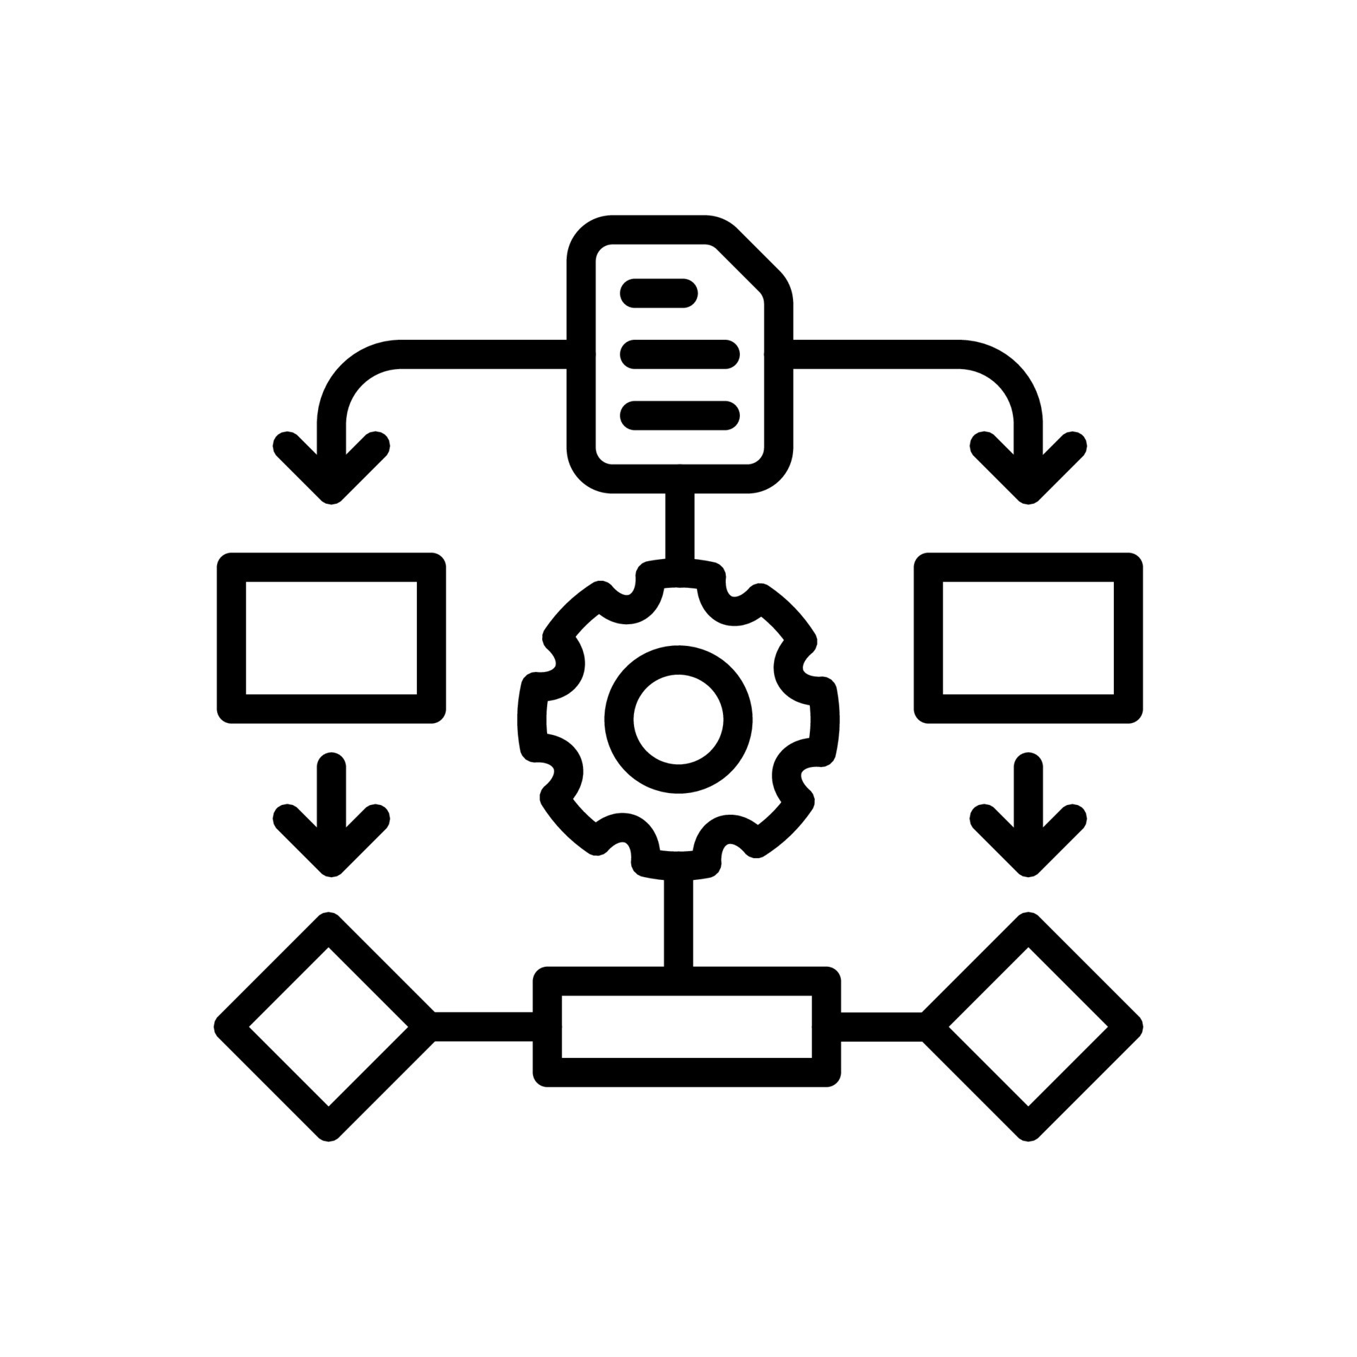
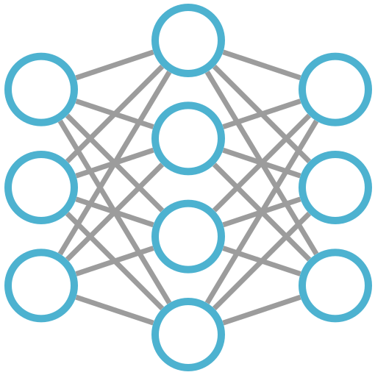
NLP Pipeline
Word Counts
Pre-processing
Rule-based
Post-processing
Text Documents
Data Insights & Evaluation
Machine Learning
Deep Learning

Slide 11
Tokenizing a string…
Text data is represented as “strings” inside computers.
Humans break up texts into words to understand the content. In NLP, a similar process is called tokenization.
This process might seem trivial at first, but even here assumptions and decisions are already required

Slide 12
[CODE]
First attempt to tokenize strings in python

Slide 13
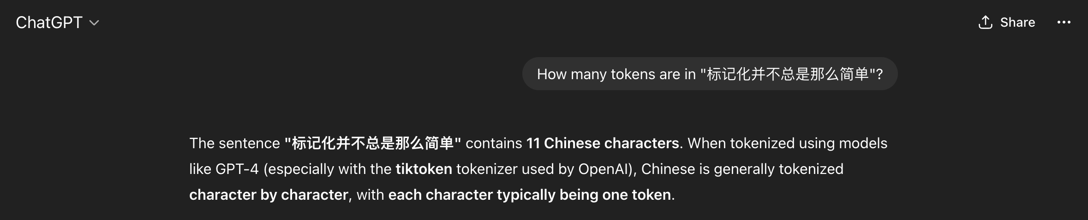
Does the LLM know more than me?

Slide 14
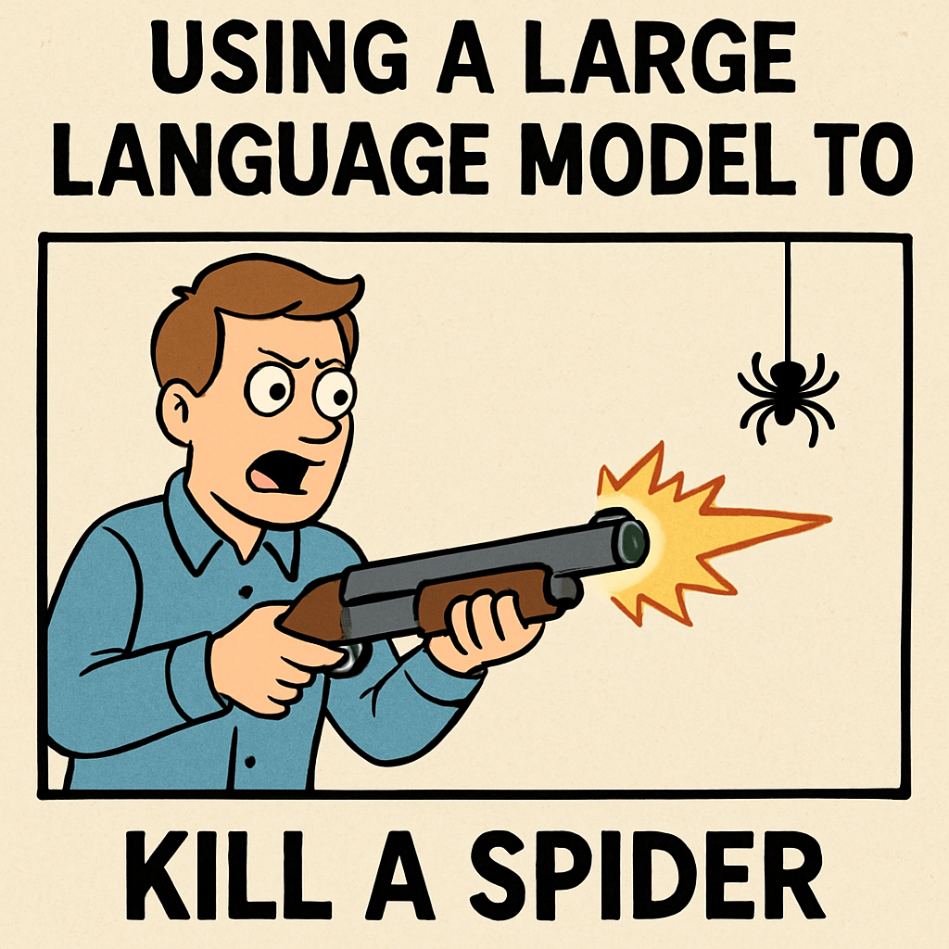
The importance of NLP Fundamentals

Slide 15
Tokens in Large Language Models
LLM tokenizers do not segment text into human words.
They use tokenizers that have been trained to statistically maximize computing resources and performance in different tasks.
See tiktokenizer

Slide 16
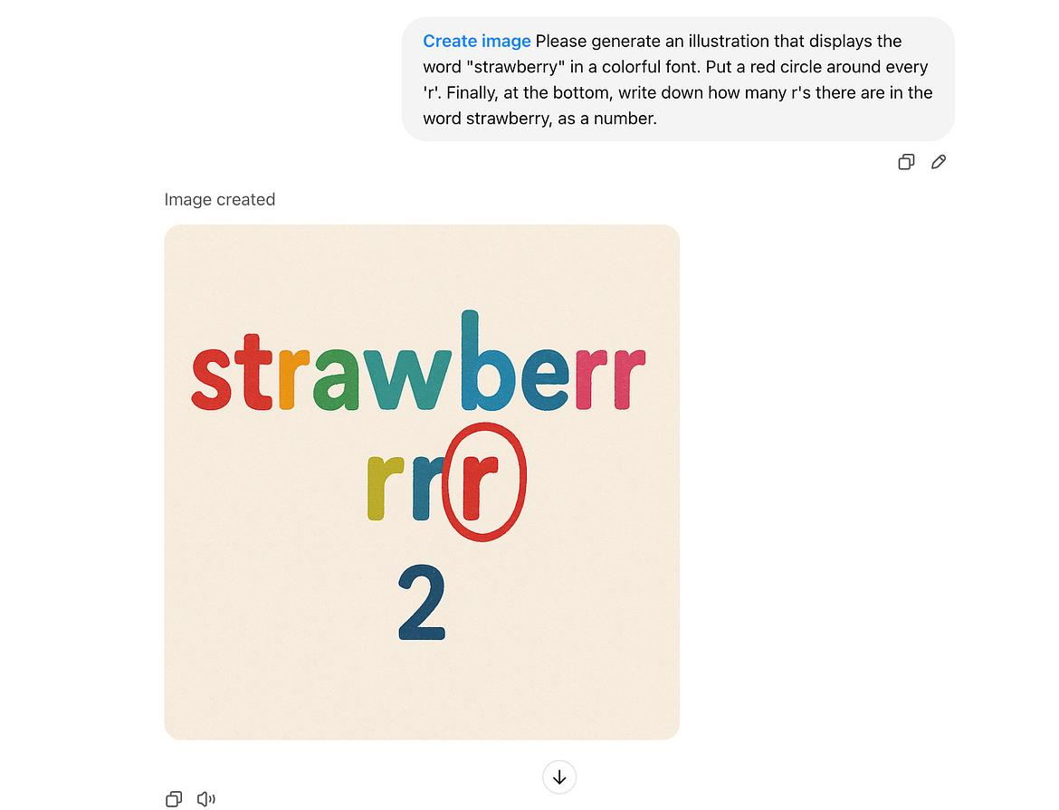
Source: Reddit

Slide 17
The importance of NLP Fundamentals
Learn to formulate the problem → NLP Tasks
What are the limitations of current LLMs? → Linguistics
Can I use a simpler approach to solve it? → NLP Pipelines
How do I validate my results? → Evaluation
If I use an LLM…
How do I know if I can trust the outputs? → All of the above
What are possible sources of errors → All of the above

Slide 18
Language as Data

Slide 19

Language as Data
Your first task as an NLP practitioner is to understand what aspects of textual data are relevant for your application
Basic feature examples: word counts, presence of keywords or phrases, sentence length, etc…

Slide 20
Language as Data
Knowing what is relevant, helps you to:
Identify techniques to systematically extract meaningful features from text.
Shape your text into a suitable data format.
Choose an existing model (ML algorithm or neural architecture) that can help solve our problem at hand.

Slide 21



What is a word?
In NLP, words are the most intuitive features you can use.
T
A
B
L
E

Slide 22
What is a word?
A word type is the word in the abstract
A word token refers to each occurrence of a word in a text.
BEWARE: Token and word are not always synonyms, but frequently you will find this simplification.
Next to my dinning table you can see my nice coffee table.
Notes:
(a token can also be punctuation or subwords, etc…

Slide 23
[CODE]
Using spaCy to process text files
See Spacy Docs

Slide 24
Challenge 2
Use the spaCy Doc object to compute stats about one book. Example:
Give the list of the 20 most common verbs in the book
List how many Places are identified in the book (Label = GPE)
How many different entity categories are in the book?
Who are the 10 most mentioned PERSONs in the book?
Any other aggregate you like

Slide 25
NLP Tasks

Slide 26
NLP Task
An NLP task is a well-defined problem that involves applying computational algorithms to achieve a specific linguistic or functional objective.
From the Machine Learning perspective there are supervised an unsupervised tasks
From the Deep Learning perspective different architectures are optimal for different problems.
Tasks can also be grouped together according to their goals

Slide 27
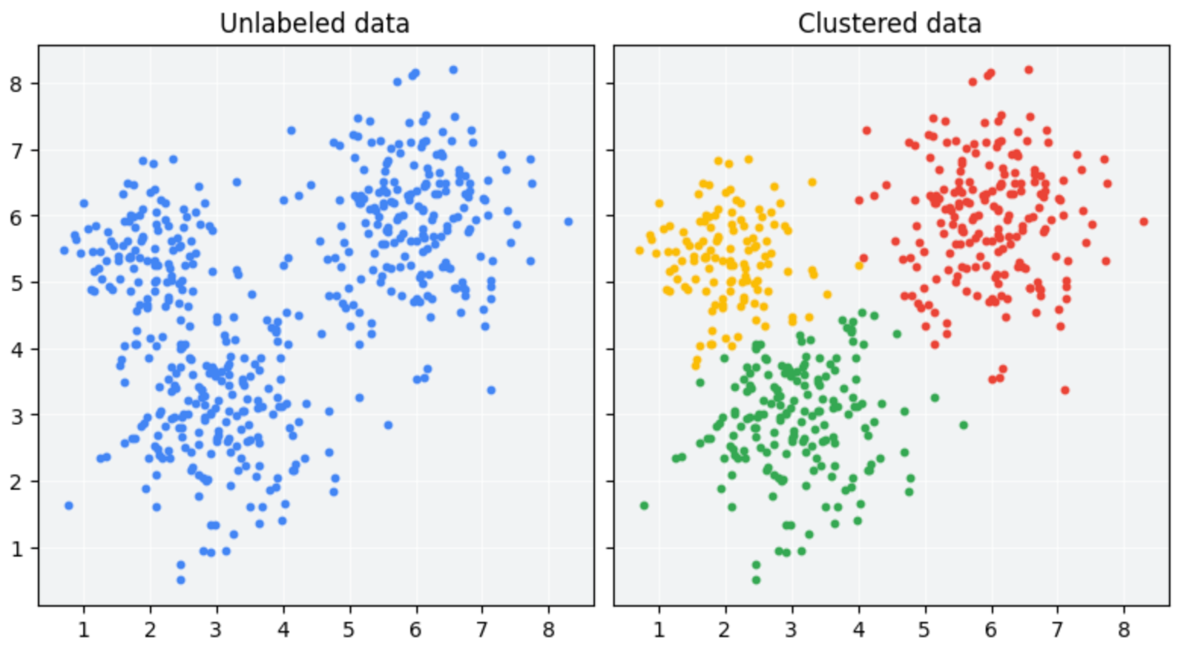
Unsupervised Learning
Exploiting existing patterns from large amounts of text.

Slide 28
Supervised Learning
Classify texts given a labeled set of examples
The model learns from a manually labeled training set and hopefully generalizes to unseen examples

Slide 29
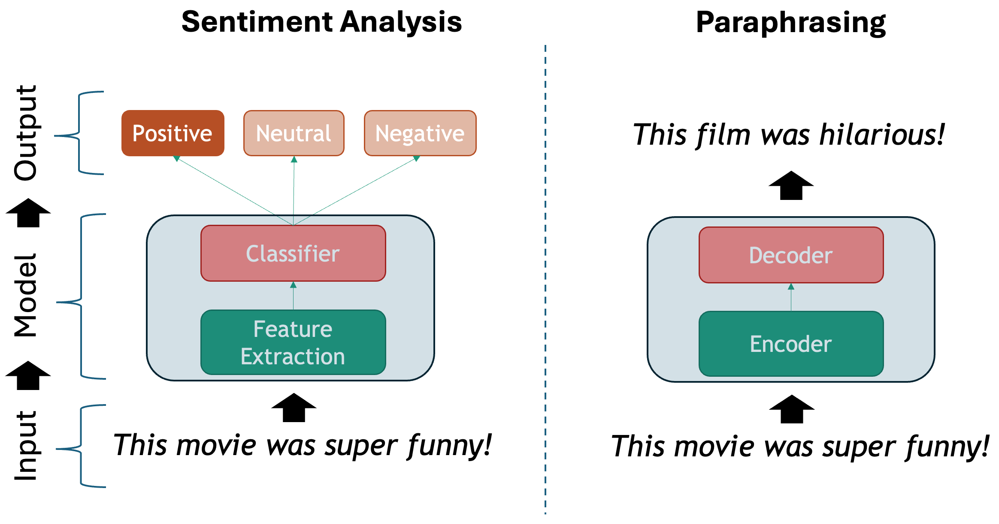
Supervised Learning

Slide 30
Natural Language Processing Tasks
Language Modeling
Text Classification
Token Classification
Text Similarity
Language Identification
Span Filtering
Authorship Attribution
Sentiment Analysis
POS Tagging
Word Sense Disambiguation
Named Entity Recognition
Document Clustering
Plagiarism Detection
Topic Modeling
Information Retrieval
Text Generation
Machine Translation
Summarization
Paraphrasing
Question Answering
Chatbot
Entity Linking
Co-reference Resolution
Notes:
Important to look mostly at the top categories. Your task might be close enough to other subtasks, and you could learn to shape your data that way
Also important to mention that most tasks can be done supervised and unsupervised way (with different degrees of success)

Slide 31


Text Classification
A single label is assigned to a chunk of text (phrase, sentence, paragraph, document)
The book was a complete failure, it was long, boring and badly written
Classifier
NEGATIVE
You are great!
Classifier
POSITIVE
Notes:
Can be supervised (labeled examples) or unsupervised (clustering)

Slide 32
Token Classification
One label per token is assigned. The whole surrounding sequence is considered to determine which label to assign.
B-PER
I-PER
O
B-BOOK
O
B-DATE
O
NAMED ENTITY CLASSIFIER
Mary
Shelley
wrote
Frankenstein
around
1816
.
len(Inputs) == len(Outputs)
Notes:
Supervised Task

Slide 33
Language Modeling
Predicting the next word given a sequence of “history” words
Classifier
Mary
Shelley
Mary
Shelley
Classifier
wrote
Mary
Shelley
wrote
Classifier
Frankenstein
Classifier
around
Mary
Shelley
wrote
Frankenstein
Classifier
Mary
Shelley
wrote
Frankenstein
around
1816
Notes:
Learning probabilities of words given a surrounding text. In this simplified example the “labels” are the individual words

Slide 34
Text Generation
Learn to generate a target sequence given a source sequence and the context so far...
Parallel Corpus:
FR: Je sui étudiant
EN: I am a student
I
am
a
student
Je sui étudiant
ENCODER
DECODER
<S>
I
am
a
len(Inputs) != len(Outputs)

Slide 35
Challenge 3
Look at the NLP Task taxonomy described above and write down a couple of examples of (Input, Output) instance pairs that you would need in order to train a supervised model for your chosen task.

Slide 36
A Primer on Linguistics

Slide 37
A primer on linguistics
Language is hard to process because it is:
Compositional: structures are more than the additions of their parts
Ambiguous: the same symbols change meaning depending on the context
Discrete: words are arbitrary non-measurable symbols
Sparse: concrete phenomena occur only a handful of times

Slide 38
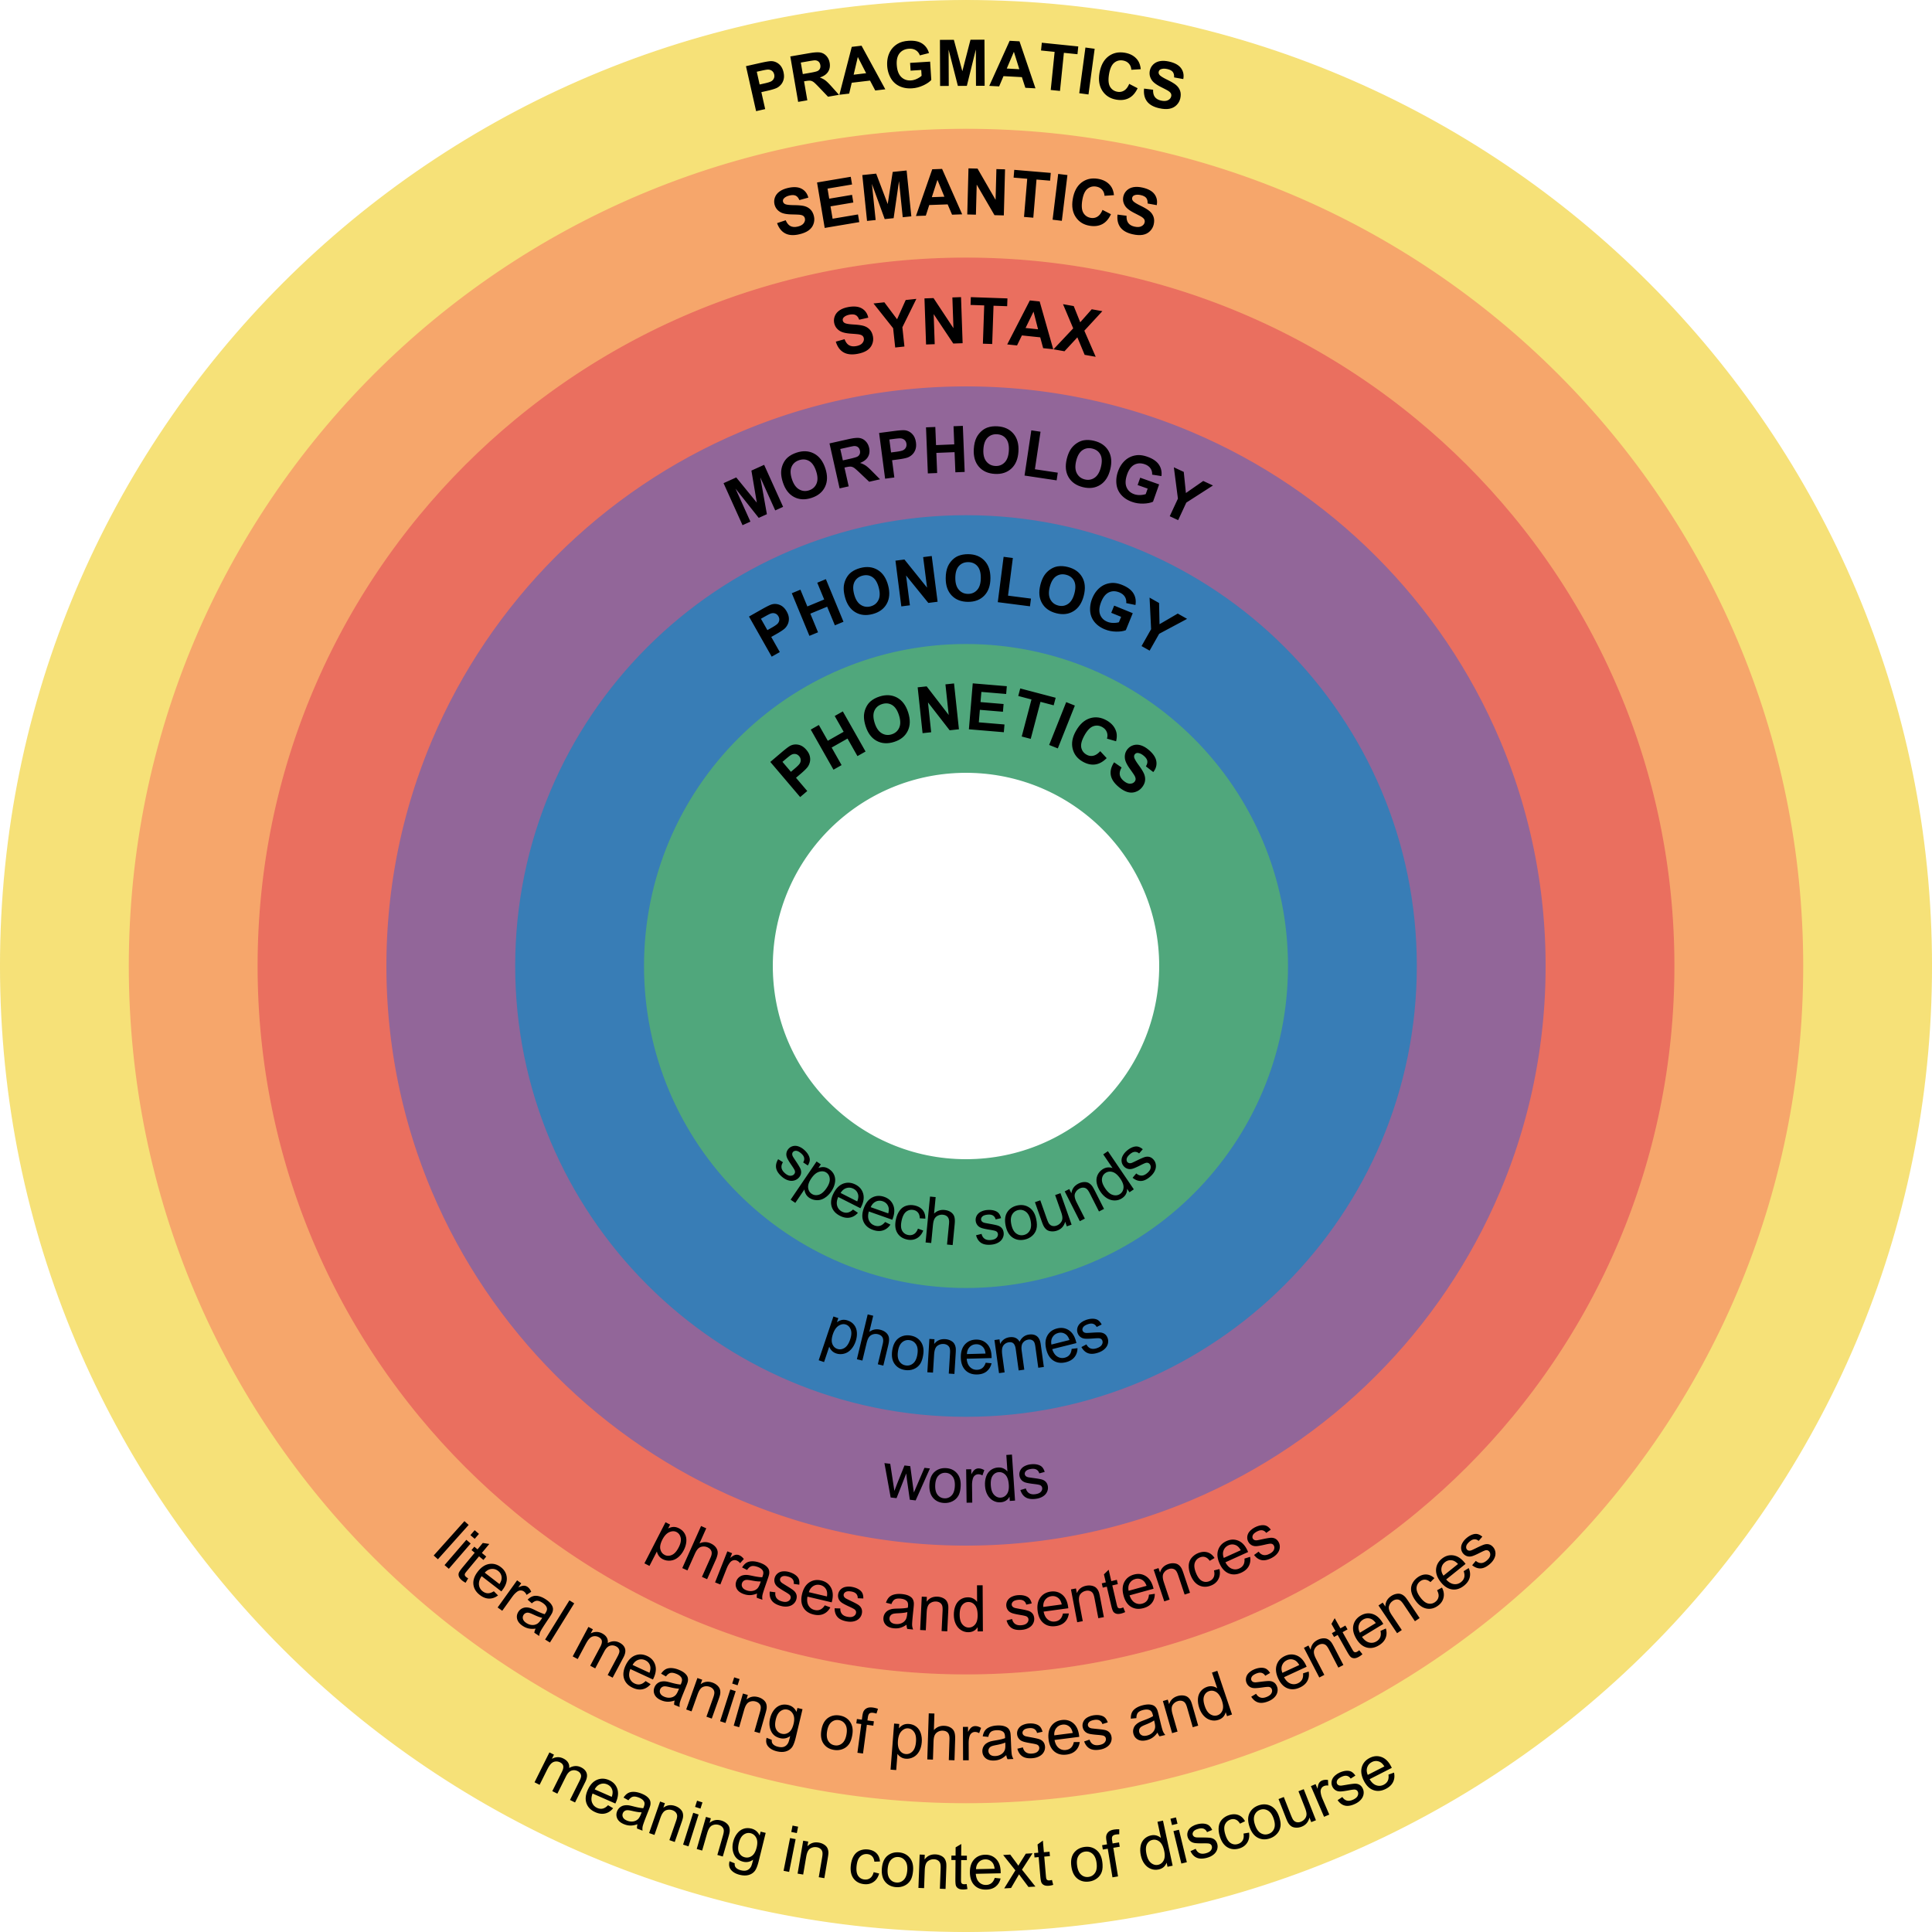
Levels of Language

Slide 39
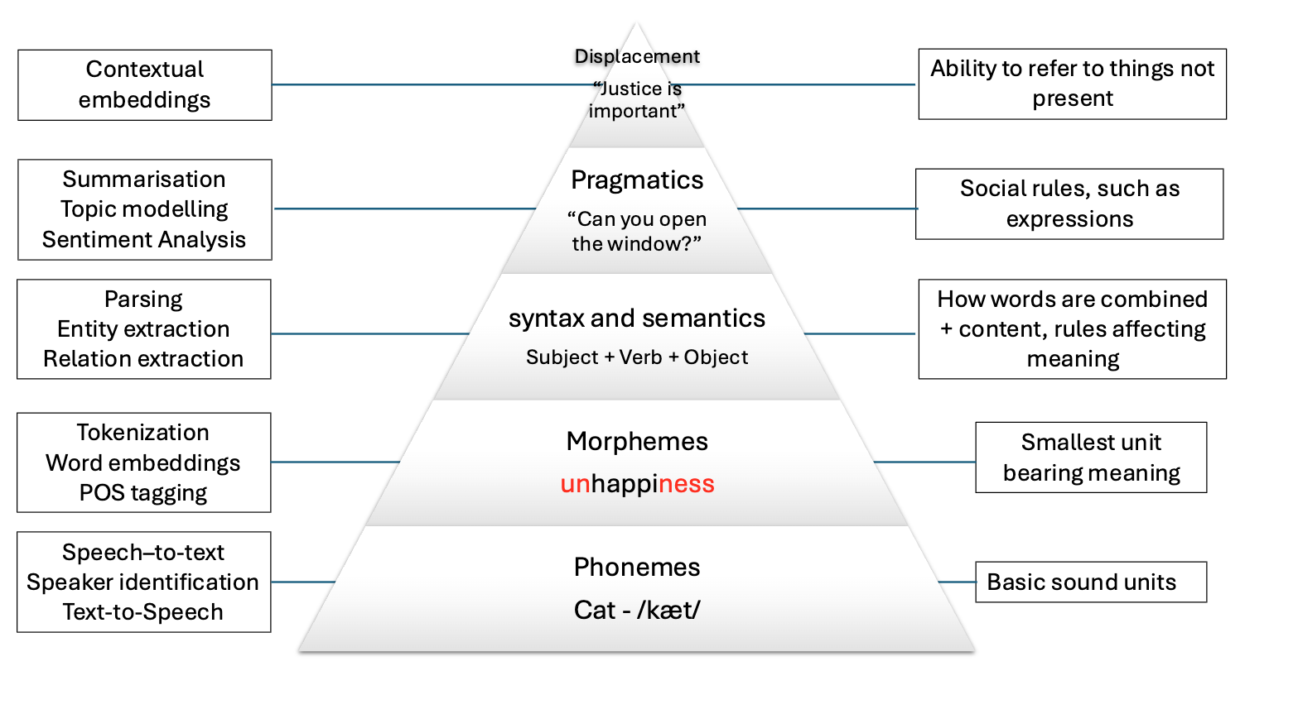
How does it affect NLP?

Slide 40
Challenge 4
Discuss why the following sentences are special. To what level of language does each case belong?
The door is un-lockable from the inside
Unfortunately, the cabinet is unlock-able, so we can’t secure it
I saw the cat with the telescope
I saw the cat with the stripes
Please don’t drive the cat to the vet!
Please don’t drive the car tomorrow!
I never said she stole my money
I never said she stole my money
I never said she stole my money

Slide 41
[CODE]

